Slide 1

DEPARTMENT OF COMPUTER SCIENCE & ENGINEERING
SCHOOL OF COMPUTING
1156CS601- MINOR PROJECT
WINTER SEMESTER 22-23
SEMESTER END PROJECT VIVA VOCE EXAMINATIONS
OPTIMIZED U-NET ARCHITECTURE FOR BRAIN TUMOR SEGMENTATION
SUPERVISED BY
Mr. S. SARAN RAJ
ASSISTANT PROFESSOR
PRESENTED BY
LOGESHWARAN K S (VTU15366) (20UECS0530)
SATWIKA B (VTU15368) (20UECS0852)
FAZEL KHAN P (VTU17589) (20UECS0729)

Slide 2
AGENDA
ABSTRACT
OBJECTIVE
INTRODUCTION
LITERATURE REVIEW
DESIGN AND METHODOLOGIES
STANDARDS & POLICIES USED
IMPLEMENTATION
TESTING
INPUT AND OUTPUT
INCLUDE DEMO VIDEO
CONCLUSION
FUTURE ENHANCEMENTS
WEB REFERENCES LINK
REFERENCES
PLAGIARISM REPORT OF PPT
POSTER PRESENTATION

Slide 3
ABSTRACT
Brain cancer is a fatal disease with little chance of survival. One of the most important tasks of neurologists and radiologists is detecting brain tumors.
Brain tumors can be benign (noncancerous) or malignant (cancerous) which affects adults and children. However, whether a brain tumor is cancerous or not, it can affect how the brain works if it becomes large enough to compress surrounding tissue.
MRI is the most common method for diagnosing brain tumors. Brain tumor segmentation using the U-Net uses more layered structure to autonomously and accurately determine the size and location of brain tumors from MRI.

Slide 4
OBJECTIVES
Aim of the Project:
The main goal of this project is to find brain tumors with high accuracy using an optimized u-net architecture. It can even help the people who are at the earlier stage by detecting the location and extension of the tumor regions.
Scope of the Project:
The scope of brain tumor segmentation using U-Net architecture is to accurately describe the brain tumor site with creating mask to MRI images.

Slide 5
INTRODUCTION
Over the past few decades, the field of medical imaging has undergone a revolution with the application of machine learning and deep learning algorithms for the segmentation, identification, and prediction of patient survival from tumors or other diseases.
In addition, it helps doctors make an early diagnosis of malignant brain tumors, thus improving the prognosis. Gliomas occur most often in adults and are thought to arise from glial cells and invade adjacent tissues.
The primary brain tumor is a glioma. High-Grade Glioblastoma (HGG) and Low-Grade Glioblastoma (LGG) are two other subtypes of glioma. While radiologists manually reviewed Magnetic Resonance Imaging (MRI) modalities to generate quantitative information, segmentation of 2D modalities is cumbersome, with variations and errors.

Slide 6
INTRODUCTION
This challenge is further heightened if tumors vary in size, shape, and location. Tumor-like cells can appear anywhere in brain tissue and can vary in size, appearance, and shape, and it is difficult to automatically segment brain tumors and their subregions. CNNs of different architectures have and use automatic segmentation.
We made the U-NET architecture model to help physicians improve their performance by performing initial analyses with the automatic and intelligent systems provided.

Slide 7
LITERATURE REVIEW
1. Tejas Shelatkar, Dr. Urvashi, Mohammad Shorfuzzaman, Abdulmajeed Alsufyani, Kuruva Lakshmanna, “Diagnosis of Brain Tumor Using Light Weight Deep Learning Model with Fine-Tuning Approach”, Computational and Mathematical Methods in Medicine , 2022.
It applies different variations of the YOLOv5 algorithm to the Brats 2020 annotated dataset to detect the location of brain tumors.
It was able to achieve 82-92% accuracy for YOLO variants, where the YOLOv5l model gave us better accuracy than YOLOv5n and YOLOv5s.
Object detection models for brain tumor analysis were slightly less accurate than classification and segmentation models. But we also observed a significant reduction in training time and model size.

Slide 8
LITERATURE REVIEW
2. Nahian Siddique, Sidike Paheding, Colin P. Elkin, Vijay Devabhatuni, ”U-Net and Its Variants for Medical Image Segmentation: A Review of Theory and Applications”, Digital Object Identifier, 2021.
It aims to provide a starting point for researchers wishing to explore U-net, a powerful deep learning model widely used in medical image segmentation.
It explores the many variations of the U-net and its various applications through multiple imaging modalities.
It explores the main deep learning methods and their areas of application from all the articles in this survey.

Slide 9
LITERATURE REVIEW
3. Samia Mushtaq, Apash Roy, Tawseef Ahmed Teli, “A Comparative Study on Various Machine Learning Techniques for Brain Tumor Detection Using MRI”, Global Emerging Innovation Summit, 2021.
This shows some machine learning techniques and a comparative analysis of the current literature was performed. To understand the benefits of using deep learning methods such as convolutional neural networks, compare the performance of ANNs and CNNs.
The performance difference clearly demonstrates that CNNs work even on unbalanced datasets without any proper preprocessing consideration.

Slide 10
LITERATURE REVIEW
4. P. Khan, M. F. Kader, S. M. R. Islam et al., “Machine learning and deep learning approaches for brain disease diagnosis: principles and recent advances,” IEEE Access, vol. 9, pp. 37622–37655, 2021.
It presented a survey on the four most dangerous brain disease detection processes using machine and deep learning. The survey reveals some important insights into contemporary ML/DL techniques in the medical field used in today’s brain disorder research
With the passage of time, identification, feature extraction, and classification methods are becoming more challenging in the field of ML and DL.

Slide 11
LITERATURE REVIEW
5. Getao Du, Xu Cao, Jimin Liang, Xueli Chen, and Yonghua Zhan, “Medical Image Segmentation based on U-Net: A Review”, Journal of Imaging Science and Technology, 2020.
This show that the DL method based on the CNN has been widely recognized in medical image classification, segmentation, and other fields.
The U-net network structure is used to solve many problems related to image shadow and overlap. This is not only a breakthrough of DL in medical image processing, but also sets a foundation for doctors to obtain accurate pathologic diagnosis in the future.

Slide 12
LITERATURE REVIEW
6. A. Rehman, S. Naz, M. I. Razzak, F. Akram, and M. Imran, “A deep learning-based framework for automatic brain tumors classification using transfer learning,” Circuits, Systems, and Signal Processing, vol. 39, no. 2, pp. 757–775, 2020.
It presents a pioneer study in the domain of brain tumor classification using transfer learning and deep CNN architectures. We applied transfer learning techniques using natural images of ImageNet dataset (source task) and classified the brain tumor type from glioma, meningioma, and pituitary.
This paper explored three architectures of deep CNN and transfer learning approaches for brain tumor in the medical imaging domain,

Slide 13
LITERATURE REVIEW
7. Micha l Futrega, Alexandre Milesi, Micha l Marcinkiewicz, Pablo Ribalta, “Optimized U-Net for Brain Tumor Segmentation”, NVIDIA, Santa Clara , 2021
It run extensive ablation studies to select both an optimal U-Net variant and training schedule for the BraTS21 challenge. We have tested U-Net.
optimized our model further by increasing the encoder depth, adding one-hot-encoding channel for the foreground voxels to the input data, and increasing the number of convolutional layers.

Slide 14
LITERATURE REVIEW
8. Ali Ari, Davut Hnabay “Deep learning based brain tumor classification and detection system”, Turkish Journal of Electrical Engineering and Computer Sciences , 2018.
It seems to have really fast training mechanism but contains only one hidden layer. since too few/many hidden nodes employed would lead to under- fitting/over-fitting issues in pattern classification
It applies random distortion, like some other techniques like DNA , It apply Gaussian noise.

Slide 15
LITERATURE REVIEW
9. T.M. Shahriar Sazzad, K.M. Tanzibul Ahmmed, M.U. Hoque, and M. Rahman, "Development of Automated Brain Tumor Identification Using MRI Images", 2nd Int. Conf. Electr. Comput. Commun. Eng. ECCE 2019, 2019 pp. 1-4
I segment the brain tumor using otsu method. 2D Otsu's method is more robust compared to 1D Otsu's method, but it still has limitations on salt-and-pepper noise corrupted images and uneven illumination images. It makes the major drawback in segmentation.
It also uses median filter and image enhancement for representation.

Slide 16
LITERATURE REVIEW
10. Aboli Kapadnis, “Brain Tumor Detection using Transfer Learning with AlexNet and CNN”, National College of Ireland, 2021.
This paper uses alexnet for brain tumor segmentation which is computationally expensive and causes overfitting. It requires large dataset to train or validate the brain tumor and limited interpretability.
Additionally, since AlexNet was first trained on large datasets of natural images, it was able to learn about many common features that can be found in MRI images.

Slide 17
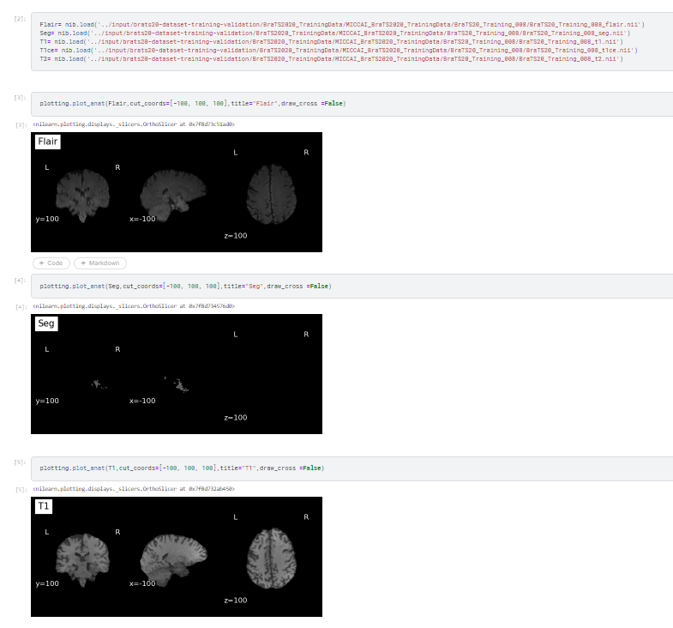
DESIGN AND METHODOLOGIES
Data Extraction
Model Extraction module express the BRATs 2020 dataset, as it contains 5 different modularity in the both train and validate folder.

Slide 18
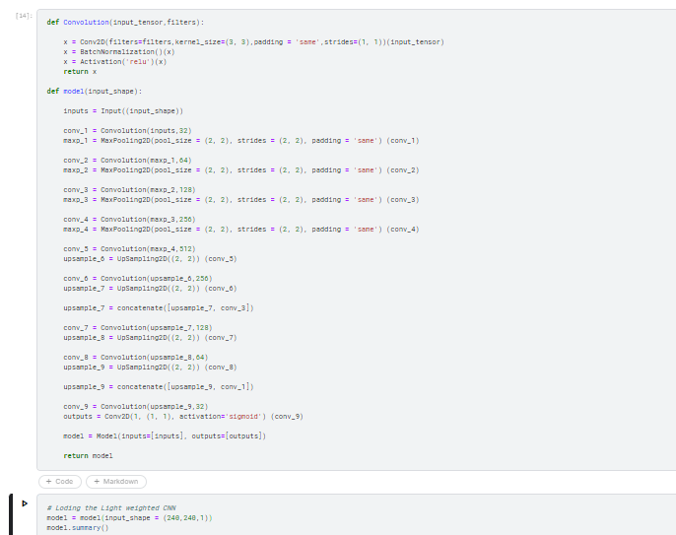
DESIGN AND METHODOLOGIES
Model Building
We Built the model with contraction and expansion ( 4 – Convolutional Layer, 4 Max Pooling)

Slide 19
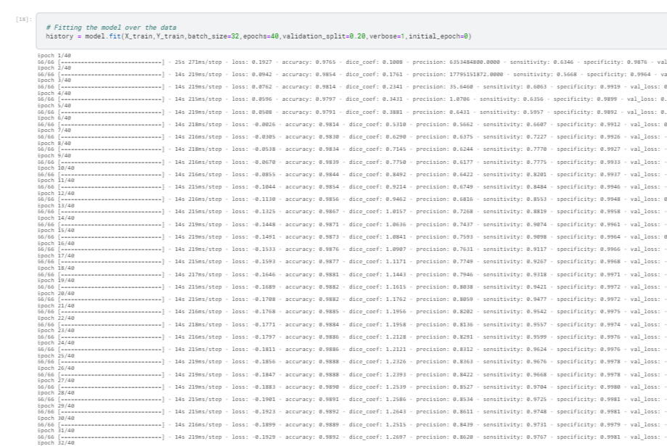
DESIGN AND METHODOLOGIES
Model Training
Training model consists of 40 epoch with 32 batch size with gives the result of approximately 90 percent accuracy and 1 percent loss.

Slide 20
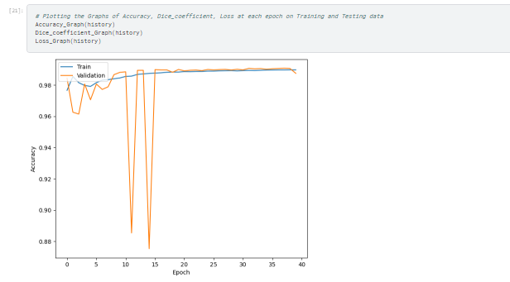
DESIGN AND METHODOLOGIES
Model Evaluation
Model Evaluation module express about the deciding factor of the U-Net architecture model. As we obtained approximately 99 percentage as accuracy.

Slide 21
IMPLEMENTATION
Architecture Diagram
Data –Flow Diagram

Slide 22
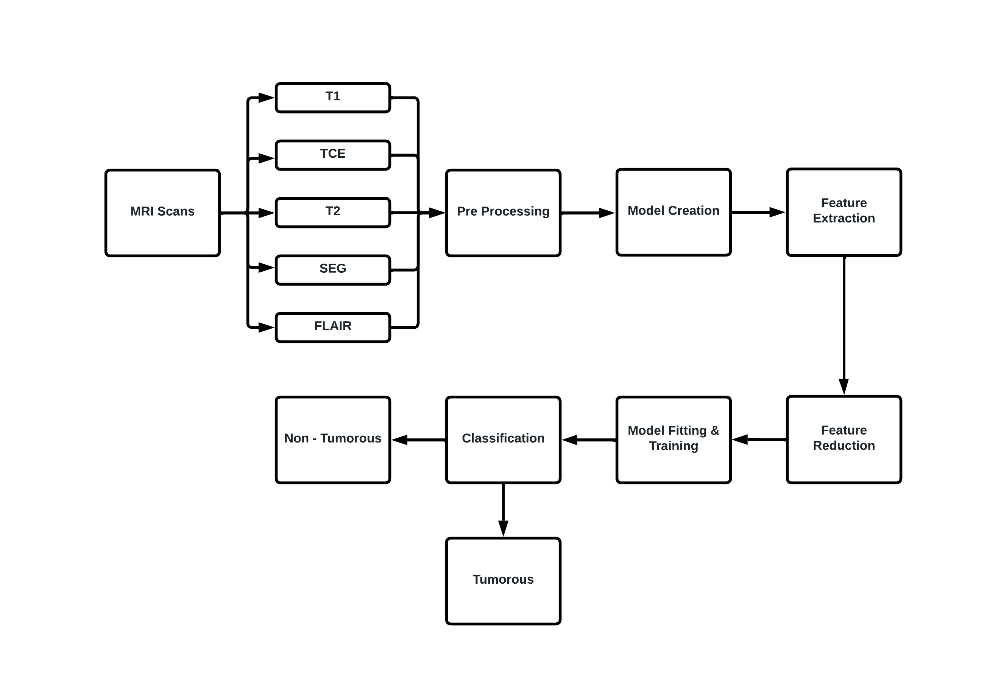
ARCHITECTURE DIAGRAM

Slide 23
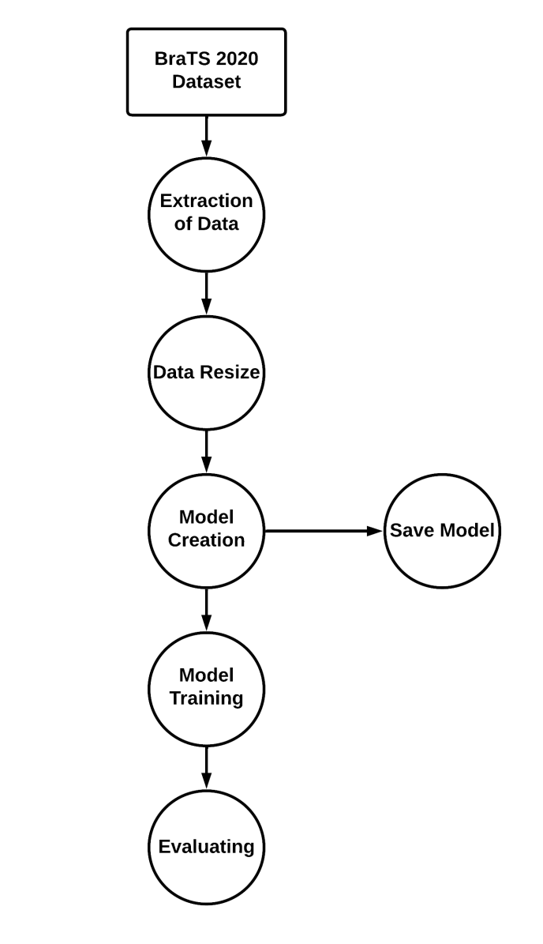
DATA FLOW DIAGRAM

Slide 24
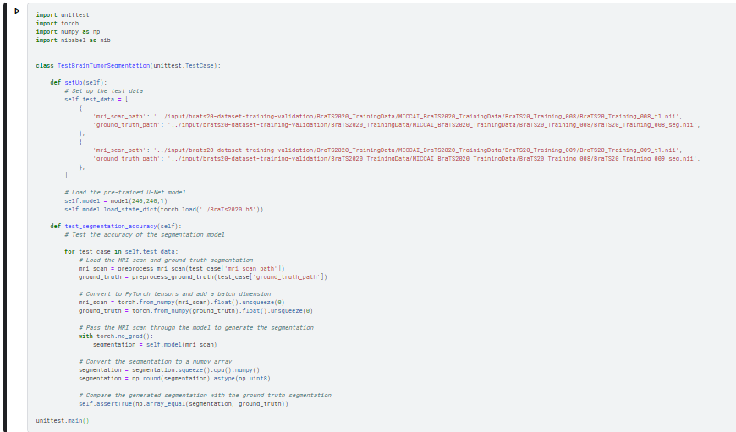
TESTING
UNIT TESTING

Slide 25
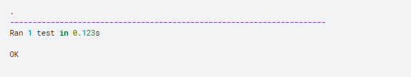
UNIT TESTING

Slide 26
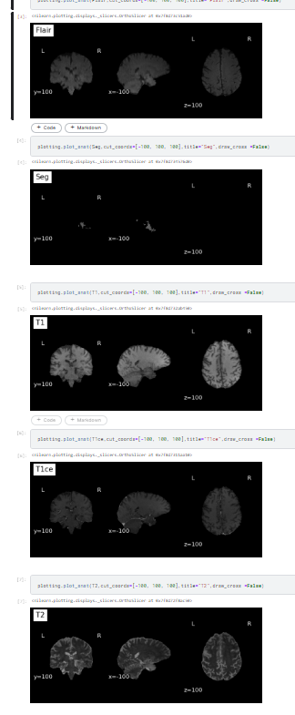
INPUT AND OUTPUT
SCREENSHOTS : INPUT

Slide 27
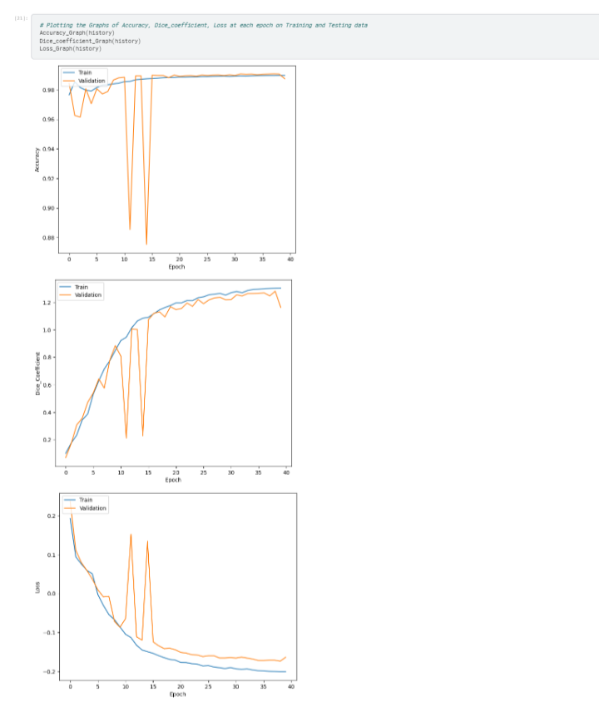
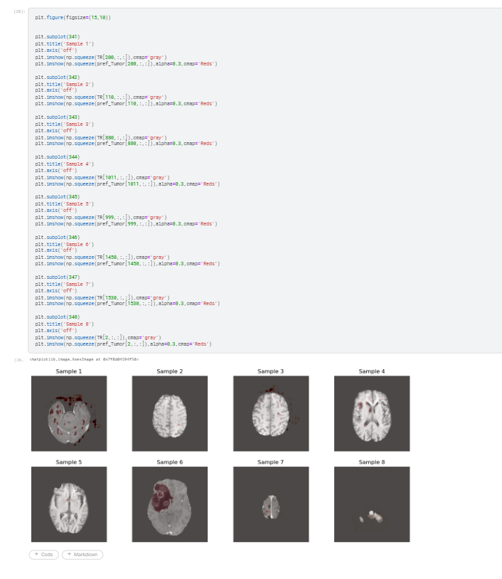
SCREENSHOTS : OUTPUT

Slide 28
STANDARDS & POLICIES
KAGGLE
Kaggle is a popular online platform for data scientists and machine learning professionals to participate in data science competitions, collaborate with others, and learn from other experts in the field. Kaggle hosts a variety of data science challenges that provide participants with datasets and specific tasks to solve Classification or Regression. Participants can submit their solutions and receive a score based on their model’s performance on the hosted test dataset. Standard Used: ISO/IEC 27001

Slide 29
CONCLUSION
The U-Net architecture has shown promising results in the task of brain tumor segmentation. The BraTS 2020 dataset contains multimodal MRI scans of brain tumors and corresponding segmentation masks, making it a challenging dataset for segmentation tasks. It included scans of 769 patients, including High-Grade Glioma and Low-Grade Glioma. The data were divided into a training subset and a validation subset, with 369 patients in the training subset and 400 patients in the validation subset. However, U-Net has been shown to achieve state-of-the-art performance in this task, achieving high accuracy and Dice Similarity Coefficient scores. The U-Net architecture has the ability to handle the complex shape and texture of the tumor, its ability to handle multi-modal MRI scans, and its ability to segment the tumor region with high accuracy. The resulting accuracy of our model is around 99 %. U-Net architecture can be further used for other medical diagnoses with hybrid methodology.

Slide 30
FUTURE ENHANCEMENTS
Incorporating attention mechanisms to selectively focus on relevant regions and features for improved segmentation performance. Utilizing deep supervision techniques to enhance feature representation and improve the accuracy of the model. Exploring the use of U-Net architectures to capture more spatial information and enable more accurate segmentation of irregularly shaped tumors. Investigating the use of Generative Adversarial Networks (GANs) for data augmentation and improving the generalization capability of the model. Integrating multi-task learning with U-Net for joint segmentation of brain tumors and other brain structures or abnormalities. Implementing transfer learning techniques to improve the model’s performance on new or unseen datasets. Evaluating the model’s performance on more diverse and challenging datasets, including datasets with larger variations in tumor size, location, and type.

Slide 31
WEB REFERENCES LINK
Brain Tumor
https://www.mayoclinic.org/diseases-conditions/glioma
Dataset : BRATs 2020
https://www.kaggle.com/datasets/awsaf49/brats20-dataset-training-validation
U-Net Architecture
https://towardsdatascience.com/unet-line-by-line-explanation-9b191c76baf5
Image Segmentation
https://pyimagesearch.com/2022/02/21/u-net-image-segmentation-in-keras

Slide 32
REFERENCES(as per IEEE format only)
Tejas Shelatkar, Dr. Urvashi, Mohammad Shorfuzzaman, Abdulmajeed Alsufyani, Kuruva Lakshmanna, “Diagnosis of Brain Tumor Using Light Weight Deep Learning Model with Fine-Tuning Approach”, Computational and Mathematical Methods in Medicine , 2022.
Nahian Siddique, Sidike Paheding, Colin P. Elkin, Vijay DevabhaKtuni, ”U-Net and Its Variants for Medical Image Segmentation: A Review of Theory and Applications”, Digital Object Identifier, 2021.
Samia Mushtaq, Apash Roy, Tawseef Ahmed Teli, “A Comparative Study on Various Machine Learning Techniques for Brain Tumor Detection Using MRI”, Global Emerging Innovation Summit, 2021.

Slide 33
REFERENCES(as per IEEE format only)
P. Khan, M. F. Kader, S. M. R. Islam et al., “Machine learning and deep learning approaches for brain disease diagnosis: principles and recent advances,” IEEE Access, vol. 9, pp. 37622–37655, 2021.
Getao Du, Xu Cao, Jimin Liang, Xueli Chen, and Yonghua Zhan, “Medical Image Segmentation based on U-Net: A Review”, Journal of Imaging Science and Technology, 2020.
A. Rehman, S. Naz, M. I. Razzak, F. Akram, and M. Imran, “A deep learning-based framework for automatic brain tumors classification using transfer learning,” Circuits, Systems, and Signal Processing, vol. 39, no. 2, pp. 757–775, 2020.

Slide 34
REFERENCES(as per IEEE format only)
Micha l Futrega, Alexandre Milesi, Micha l Marcinkiewicz, Pablo Ribalta, “Optimized U-Net for Brain Tumor Segmentation”, NVIDIA, Santa Clara , 2021
Ali Ari, Davut Hanbay, “Deep learning based brain tumor classification and detection system”, Turkish Journal of Electrical Engineering and Computer Sciences , 2018.
T.M. Shahriar Sazzad, K.M. Tanzibul Ahmmed, M.U. Hoque, and M. Rahman, "Development of Automated Brain Tumor Identification Using MRI Images", 2nd Int. Conf. Electr. Comput. Commun. Eng. ECCE 2019, 2019 pp. 1-4.
Aboli Kapadnis, “Brain Tumor Detection using Transfer Learning with AlexNet and CNN”, National College of Ireland, 2021.

Slide 35
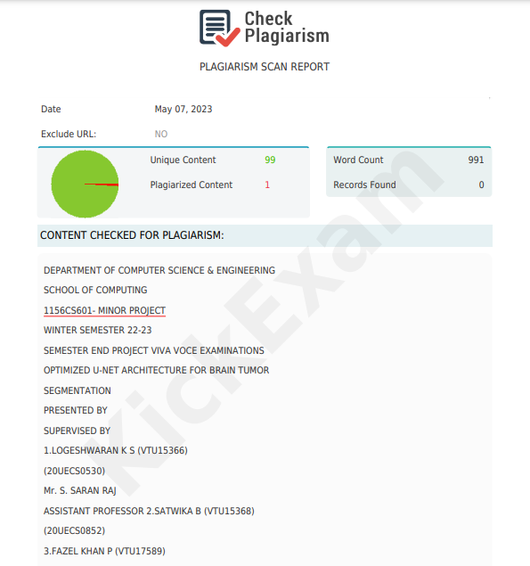
PLAGIARISM REPORT

Slide 36
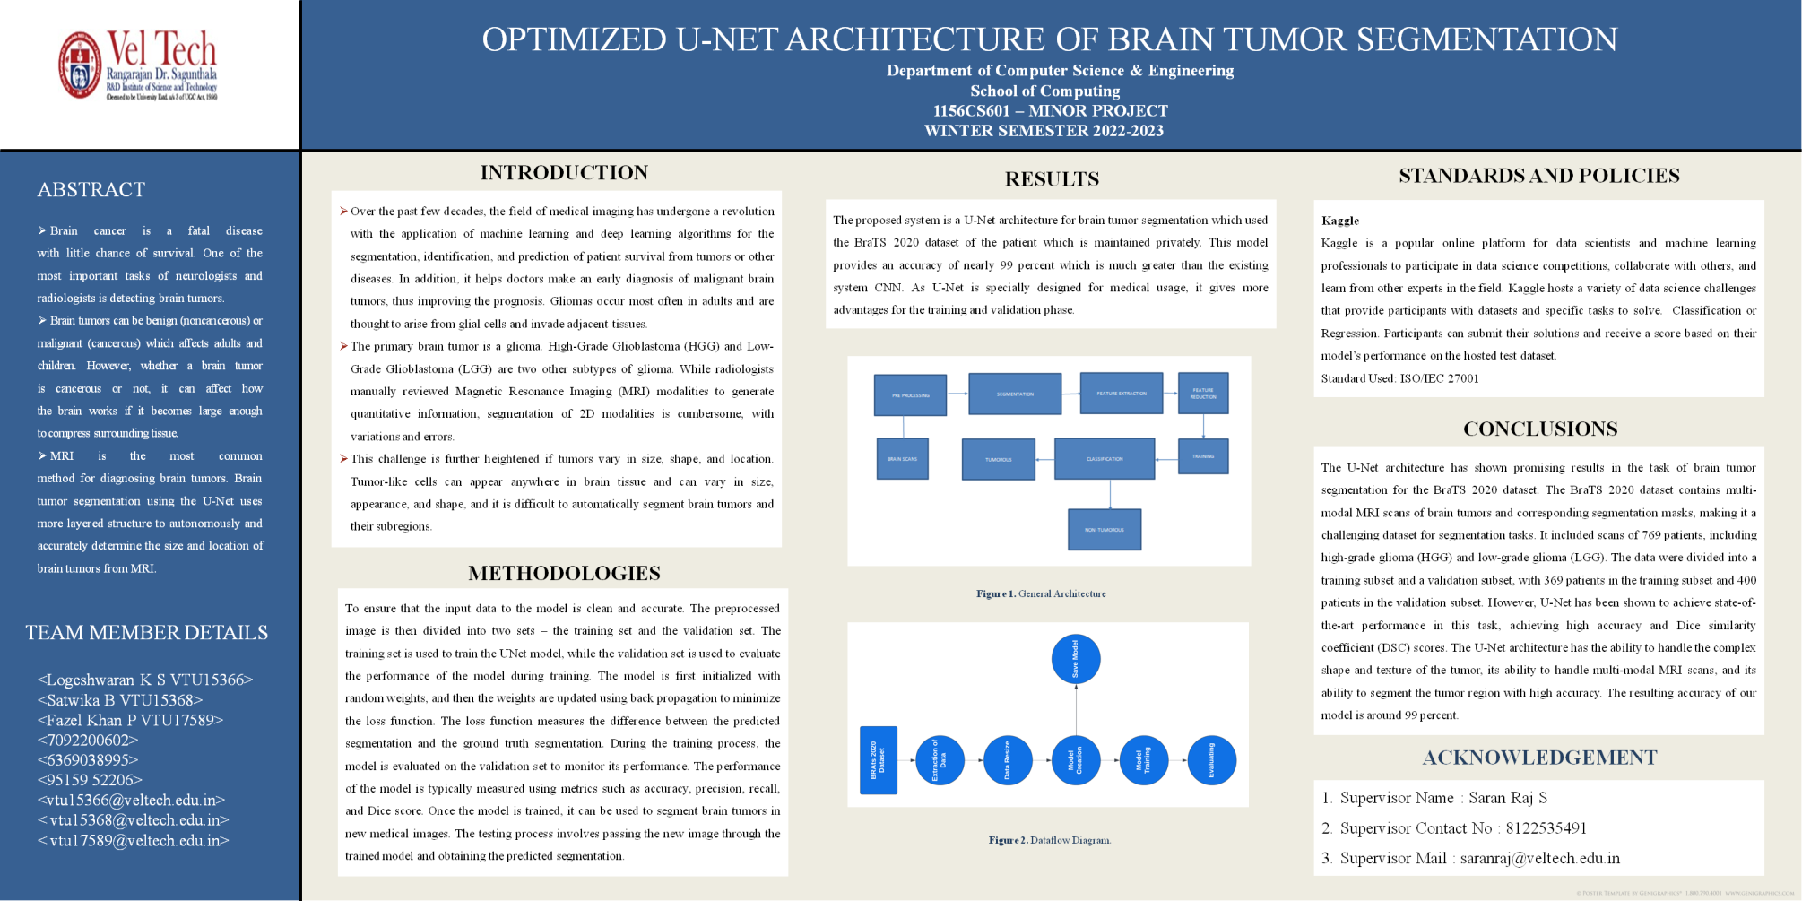
POSTER PRESENTATION

Slide 37
THANK YOU

